Slide 1
Learning long-distance dependencies via probabilistic finite-state tree automata
Roxane Martin & Yang Wang

Slide 2
Outline
“Either-Or” Dependencies & FSTAs
Expectation Maximization
Model Testing

Slide 3
Outline
“Either-Or” Dependencies & FSTAs
Expectation Maximization
Model Testing

Slide 4
Transitive Verb Object Requirement
A native English speaker’s linguistic knowledge contains the fact that transitive verbs must co-occur with an object. Can be satisfied:
by a noun phrase directly following verb
OR
by displaced wh-phrase
NOT both
1a) I know Mary bought a pie.
1b) *I know Mary bought.
2a) *I know which pie Mary bought a pie.
2b) I know which pie Mary bought.

Slide 5
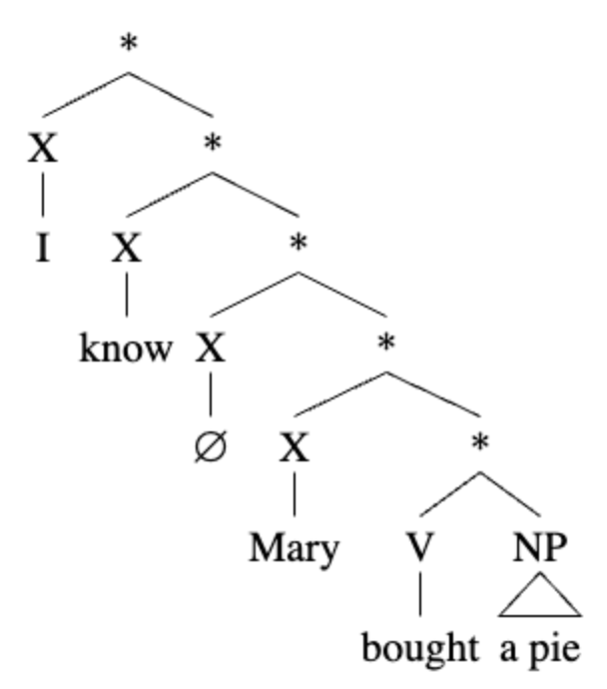
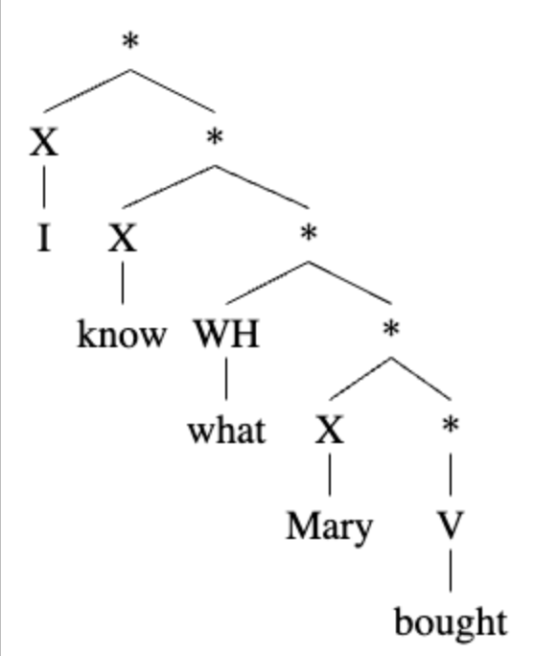
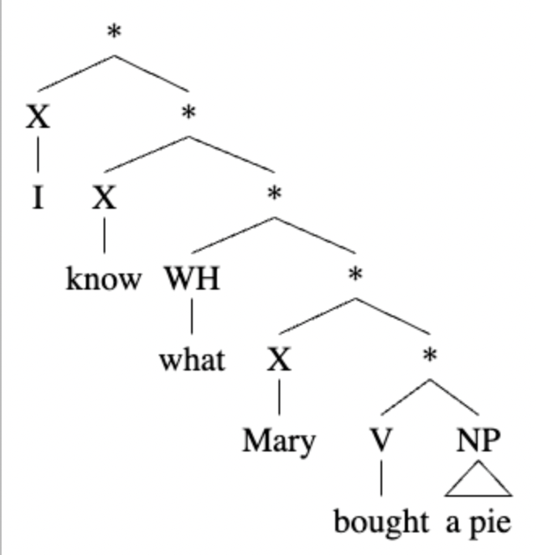
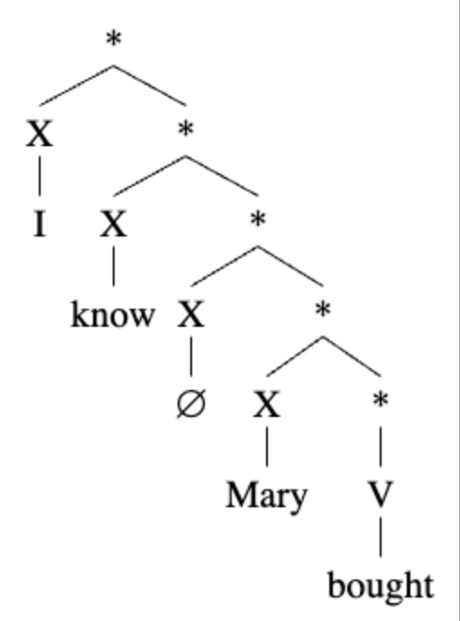
Transitive Verb Object Requirement - Trees
Allow
Disallow

Slide 6
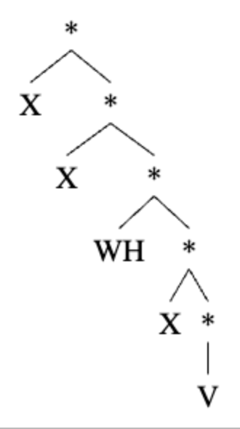
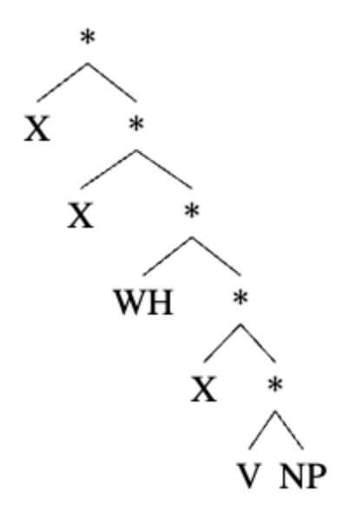
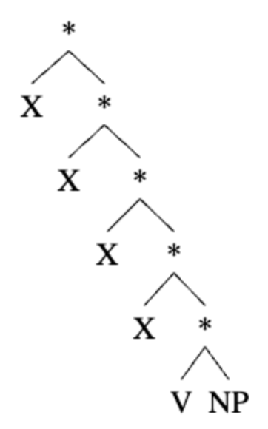
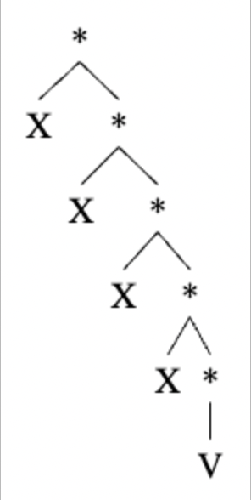
Transitive Verb Object Requirement - Simplified Trees
Allow
Disallow

Slide 7
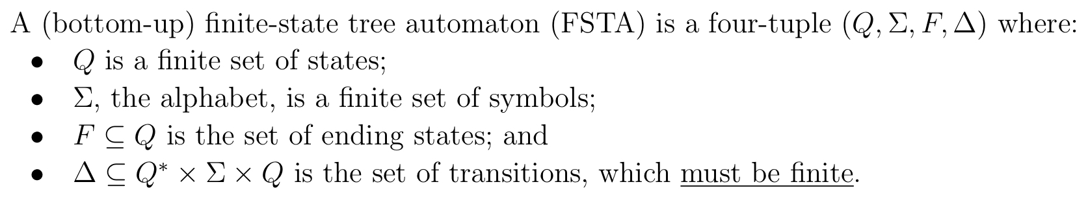
Finite State Tree Automata - Definition
I,
I
initial
A Finite-State Automata (PFSTA) is a formal grammar that can represent the either-or relations between these fulfilled object requirements, so we employ it as a candidate structure for the adult English speaker’s representation.

Slide 8
Finite State Tree Automata
Initial state: R
UL –*→ [R, UL]
UL –*→ [V]
R –*→ [L, UL]
R –*→ [R, R]
R –*→ [V, NP]
R –^{X}→ []
L –^{WH}→ []
V –^{V}→ []
NP –^{NP}→ []
V
NP
Allow
Disallow
L is the licensing state, R is the resolved state, V is the verb state, NP is the noun phrase state, and UL is the unlicensed state.
Notes:
Take your time here! Imagine you’re talking to a friend who took Ling185A a couple of years ago and hasn’t thought about it since.
The states are UL, R, V, etc. In this notation for the transitions/rules, the symbols that actually appear in the tree are shown on the arrows.
Two kinds of rules: those with the empty list on the right, for leaf nodes (no daughters); and those with a list of two states on the right, for binary non-leaf nodes …
This rule here tells us that the automaton will be in state such-and-such after processing this subtree bottom-up … This rule here tells us that it will transition to state such-and-such after processing this subtree …
etc. etc. …

Slide 9
Finite State Tree Automata
Initial state: R
UL –*→ [R, UL]
UL –*→ [V]
R –*→ [L, UL]
R –*→ [R, R]
R –*→ [V, NP]
R –^{X}→ []
L –^{WH}→ []
V –^{V}→ []
NP –^{NP}→ []
R
V
NP
Allow
Disallow
L is the licensing state, R is the resolved state, V is the verb state, NP is the noun phrase state, and UL is the unlicensed state.

Slide 10
Finite State Tree Automata
R
Initial state: R
UL –*→ [R, UL]
UL –*→ [V]
R –*→ [L, UL]
R –*→ [R, R]
R –*→ [V, NP]
R –^{X}→ []
L –^{WH}→ []
V –^{V}→ []
NP –^{NP}→ []
R
R
R
R
R
R
R
R
V
NP
V
Allow
Disallow
L is the licensing state, R is the resolved state, V is the verb state, NP is the noun phrase state, and UL is the unlicensed state.

Slide 11
Finite State Tree Automata
R
Initial state: R
UL –*→ [R, UL]
UL –*→ [V]
R –*→ [L, UL]
R –*→ [R, R]
R –*→ [V, NP]
R –^{X}→ []
L –^{WH}→ []
V –^{V}→ []
NP –^{NP}→ []
R
R
R
R
R
R
L
R
R
R
V
NP
V
V
Allow
Disallow
L is the licensing state, R is the resolved state, V is the verb state, NP is the noun phrase state, and UL is the unlicensed state.

Slide 12
Finite State Tree Automata
R
R
Initial state: R
UL –*→ [R, UL]
UL –*→ [V]
R –*→ [L, UL]
R –*→ [R, R]
R –*→ [V, NP]
R –^{X}→ []
L –^{WH}→ []
V –^{V}→ []
NP –^{NP}→ []
R
R
R
R
R
R
R
R
R
R
L
UL
WH
R
R
R
UL
R
V
NP
V
NP
V
V
Allow
Disallow
L is the licensing state, R is the resolved state, V is the verb state, NP is the noun phrase state, and UL is the unlicensed state.

Slide 13
Finite State Tree Automata
R
R
Initial state: R
UL –*→ [R, UL]
UL –*→ [V]
R –*→ [L, UL]
R –*→ [R, R]
R –*→ [V, NP]
R –^{X}→ []
L –^{WH}→ []
V –^{V}→ []
NP –^{NP}→ []
R
R
R
R
R
R
R
R
R
R
L
UL
WH
R
R
R
R
UL
R
R
V
NP
V
NP
V
V
Allow
Disallow
L is the licensing state, R is the resolved state, V is the verb state, NP is the noun phrase state, and UL is the unlicensed state.

Slide 14
Finite State Tree Automata
R
R
UL
Initial state: R
UL –*→ [R, UL]
UL –*→ [V]
R –*→ [L, UL]
R –*→ [R, R]
R –*→ [V, NP]
R –^{X}→ []
L –^{WH}→ []
V –^{V}→ []
NP –^{NP}→ []
R
R
R
R
R
UL
R
R
R
R
R
UL
R
R
L
UL
WH
R
R
UL
R
R
R
UL
R
R
R
UL
V
NP
V
NP
V
V
V
Allow
Disallow
L is the licensing state, R is the resolved state, V is the verb state, NP is the noun phrase state, and UL is the unlicensed state.

Slide 15
Outline
“Either-Or” Dependencies & FSTAs
Expectation Maximization
Model Testing

Slide 16
EM Learner
Hypothesis space of candidate PFSTAs
Expectation Maximization
Learned PFSTA
Treebank

Slide 17
EM Learner
Hypothesis space of candidate PFSTAs
Expectation Maximization
Learned PFSTA
Treebank

Slide 18
Probabilistic Finite State Tree Automata
FSTAs can be extended to Probabilistic Finite Tree Automata, by assigning probabilities to the initial states and individual transitions

Slide 19
EM Learner
Hypothesis space of candidate PFSTAs
Expectation Maximization
Learned PFSTA
Treebank

Slide 20
Expectation-Maximization: Algorithm
Statistical learning algorithm for trying to find the PFSTA that maximizes the likelihood of a treeset
Works by iterative updates from a random starting point
Since PFSTAs are a candidate structure, PFSTA learner is a candidate model for children internalizing transitive verb requirements.
Employing over-under calculations i.e. the probability of certain tree context and a certain subtree at a given node
Over
Under

Slide 21
EM Learner
Hypothesis space of candidate PFSTAs
Expectation Maximization
Learned PFSTA
Treebank

Slide 22
Constraining Hypothesis Space
We restrict our hypothesis space to only include PFSTAs that
have five states (call them 0, 1, 2, 3, 4)
put the symbols NP, V, X, WH at terminal nodes
puts the generic symbol * at internal nodes
In other words, rules like 2 –^{R}→ [3, 4] and 4 –*→ [] have probability zero for all PFSTAs in the hypothesis space
Since EM never updates a zero probability to a non-zero probability, initializing these “non-sensible” rules to have zero probability ensures that EM only searches within this range

Slide 23
Constraining Hypothesis Space
We also constrain the hypothesis space in some other, more “interesting” ways:
Assigned terminal states
e.g. the only non-zero terminal-introducing rules are
0 –^{WH}→[]
1 –^{X}→[]
2–^{V}→[]
3 –^{NP}→[]
Assuming children have learned to differentiate which lexical items belong to which parts of speech
Assigned root state
The only allowed root state is the same as the state that can introduce the terminal X.
Assuming children have learned that X is the kind of thing that can be a complete well-formed tree on its own, and that none of the other terminals can

Slide 24
Constraining Hypothesis Space
Q: [0, 1, 2, 3, 4]
I: {0: 0, 1: 1, 2: 0, 3: 0, 4: 0}
Delta:
(0, '*', (0, 1)): 0.0917
(0, '*', (2, 4)): 0.0868
(0, '*', (1, 2)): 0.0976
(0, '*', (0, 4)): 0.0197
(0, '*', (3, 4)): 0.0335
(0, '*', (2,)): 0.0858
(0, '*', (0, 2)): 0.0809
(0, '*', (2, 2)): 0.0128
(0, '*', (0,)): 0.0414
(0, '*', (1, 3)): 0.073
(0, '*', (3,)): 0.0217
(0, '*', (4, 4)): 0.0039
(0, '*', (0, 0)): 0.0523
(0, '*', (1, 1)): 0.0099
(0, '*', (0, 3)): 0.0138
(0, '*', (1, 4)): 0.0168
(0, '*', (4,)): 0.0404
(0, '*', (2, 3)): 0.0602
(0, '*', (1,)): 0.074
(0, '*', (3, 3)): 0.0572
(0, 'WH', ()): 0.0266
(0, 'X', ()): 0.0
(0, 'V', ()): 0.0
(0, 'NP', ()): 0.0
(1, '*', (0, 1)): 0.0517
(1, '*', (2, 4)): 0.0246
(1, '*', (1, 2)): 0.0628
(1, '*', (0, 4)): 0.1034
(1, '*', (3, 4)): 0.0086
(1, '*', (2,)): 0.0123
(1, '*', (0, 2)): 0.085
(1, '*', (2, 2)): 0.016
(1, '*', (0,)): 0.0579
(1, '*', (1, 3)): 0.0924
(1, '*', (3,)): 0.0099
(1, '*', (4, 4)): 0.08
(1, '*', (0, 0)): 0.0345
(1, '*', (1, 1)): 0.0062
(1, '*', (0, 3)): 0.0148
(1, '*', (1, 4)): 0.069
(1, '*', (4,)): 0.0665
(1, '*', (2, 3)): 0.0111
(1, '*', (1,)): 0.0382
(1, '*', (3, 3)): 0.0874
(1, 'WH', ()): 0.0
(1, 'X’, ()): 0.0677
(1, 'V', ()): 0.0
(1, 'NP', ()): 0.0
(2, '*', (0, 1)): 0.0703
(2, '*', (2, 4)): 0.0623
(2, '*', (1, 2)): 0.0096
(2, '*', (0, 4)): 0.0639
(2, '*', (3, 4)): 0.0687
(2, '*', (2,)): 0.0767
(2, '*', (0, 2)): 0.0655
(2, '*', (2, 2)): 0.0527
(2, '*', (0,)): 0.004
(2, '*', (1, 3)): 0.0647
(2, '*', (3,)): 0.0383
(2, '*', (4, 4)): 0.0455
(2, '*', (0, 0)): 0.0543
(2, '*', (1, 1)): 0.0112
(2, '*', (0, 3)): 0.0471
(2, '*', (1, 4)): 0.0615
(2, '*', (4,)): 0.0296
(2, '*', (2, 3)): 0.0391
(2, '*', (1,)): 0.0759
(2, '*', (3, 3)): 0.0439
(2, 'WH', ()): 0.0
(2, 'X', ()): 0.0
(2, 'V', ()): 0.0152
(2, 'NP', ()): 0.0
(3, '*', (0, 1)): 0.0181
(3, '*', (2, 4)): 0.0905
(3, '*', (1, 2)): 0.0238
(3, '*', (0, 4)): 0.0667
(3, '*', (3, 4)): 0.0133
(3, '*', (2,)): 0.0343
(3, '*', (0, 2)): 0.0924
(3, '*', (2, 2)): 0.041
(3, '*', (0,)): 0.079
(3, '*', (1, 3)): 0.0867
(3, '*', (3,)): 0.04
(3, '*', (4, 4)): 0.0152
(3, '*', (0, 0)): 0.0448
(3, '*', (1, 1)): 0.0019
(3, '*', (0, 3)): 0.0476
(3, '*', (1, 4)): 0.0114
(3, '*', (4,)): 0.061
(3, '*', (2, 3)): 0.0629
(3, '*', (1,)): 0.0752
(3, '*', (3, 3)): 0.0857
(3, 'WH', ()): 0.0
(3, 'X', ()): 0.0
(3, 'V', ()): 0.0
(3, 'NP', ()): 0.0086
(4, '*', (0, 1)): 0.0482
(4, '*', (2, 4)): 0.0973
(4, '*', (1, 2)): 0.002
(4, '*', (0, 4)): 0.0275
(4, '*', (3, 4)): 0.0393
(4, '*', (2,)): 0.0806
(4, '*', (0, 2)): 0.06
(4, '*', (2, 2)): 0.0059
(4, '*', (0,)): 0.0954
(4, '*', (1, 3)): 0.0324
(4, '*', (3,)): 0.0049
(4, '*', (4, 4)): 0.0718
(4, '*', (0, 0)): 0.0541
(4, '*', (1, 1)): 0.0128
(4, '*', (0, 3)): 0.0747
(4, '*', (1, 4)): 0.0157
(4, '*', (4,)): 0.0728
(4, '*', (2, 3)): 0.0865
(4, '*', (1,)): 0.0924
(4, '*', (3, 3)): 0.0256
(4, 'WH', ()): 0.0
(4, 'X', ()): 0.0
(4, 'V', ()): 0.0
(4, 'NP', ()): 0.0

Slide 25
EM Learner
Hypothesis space of candidate PFSTAs
Expectation Maximization
Learned PFSTA
Treebank

Slide 26
Expectation Maximization - Pruning
Q: [0, 1, 2, 3, 4]
I: {0: 0, 1: 1, 2: 0, 3: 0, 4: 0}
Delta:
(0, '*', (0, 1)): 0.0
(0, '*', (2, 4)): 0.0
(0, '*', (1, 2)): 0.0
(0, '*', (0, 4)): 0.0
(0, '*', (3, 4)): 0.0
(0, '*', (2,)): 0.0
(0, '*', (0, 2)): 0.0
(0, '*', (2, 2)): 0.0
(0, '*', (0,)): 0.0
(0, '*', (1, 3)): 0.0
(0, '*', (3,)): 0.0
(0, '*', (4, 4)): 0.0
(0, '*', (0, 0)): 0.0
(0, '*', (1, 1)): 0.0
(0, '*', (0, 3)): 0.0
(0, '*', (1, 4)): 0.0
(0, '*', (4,)): 0.0
(0, '*', (2, 3)): 0.0
(0, '*', (1,)): 0.0
(0, '*', (3, 3)): 0.0
(0, 'WH', ()): 1.0
(0, 'X', ()): 0.0
(0, 'V', ()): 0.0
(0, 'NP', ()): 0.0
(1, '*', (0, 1)): 0.0
(1, '*', (2, 4)): 0.0
(1, '*', (1, 2)): 0.0
(1, '*', (0, 4)): 0.3069
(1, '*', (3, 4)): 0.0
(1, '*', (2,)): 0.0
(1, '*', (0, 2)): 0.0
(1, '*', (2, 2)): 0.0
(1, '*', (0,)): 0.0
(1, '*', (1, 3)): 0.0
(1, '*', (3,)): 0.0
(1, '*', (4, 4)): 0.0
(1, '*', (0, 0)): 0.0
(1, '*', (1, 1)): 0.1693
(1, '*', (0, 3)): 0.0
(1, '*', (1, 4)): 0.0
(1, '*', (4,)): 0.0
(1, '*', (2, 3)): 0.3968
(1, '*', (1,)): 0.0
(1, '*', (3, 3)): 0.0
(1, 'WH', ()): 0.0
(1, 'X’, ()): 0.127
(1, 'V', ()): 0.0
(1, 'NP', ()): 0.0
(2, '*', (0, 1)): 0.0
(2, '*', (2, 4)): 0.0
(2, '*', (1, 2)): 0.0
(2, '*', (0, 4)): 0.0
(2, '*', (3, 4)): 0.0
(2, '*', (2,)): 0.0
(2, '*', (0, 2)): 0.0
(2, '*', (2, 2)): 0.0
(2, '*', (0,)): 0.0
(2, '*', (1, 3)): 0.0
(2, '*', (3,)): 0.0
(2, '*', (4, 4)): 0.0
(2, '*', (0, 0)): 0.0
(2, '*', (1, 1)): 0.0
(2, '*', (0, 3)): 0.0
(2, '*', (1, 4)): 0.0
(2, '*', (4,)): 0.0
(2, '*', (2, 3)): 0.0
(2, '*', (1,)): 0.0
(2, '*', (3, 3)): 0.0
(2, 'WH', ()): 0.0
(2, 'X', ()): 0.0
(2, 'V', ()): 1.0
(2, 'NP', ()): 0.0
(3, '*', (0, 1)): 0.0
(3, '*', (2, 4)): 0.0
(3, '*', (1, 2)): 0.0
(3, '*', (0, 4)): 0.0
(3, '*', (3, 4)): 0.0
(3, '*', (2,)): 0.0
(3, '*', (0, 2)): 0.0
(3, '*', (2, 2)): 0.0
(3, '*', (0,)): 0.0
(3, '*', (1, 3)): 0.0
(3, '*', (3,)): 0.0
(3, '*', (4, 4)): 0.0
(3, '*', (0, 0)): 0.0
(3, '*', (1, 1)): 0.0
(3, '*', (0, 3)): 0.0
(3, '*', (1, 4)): 0.0
(3, '*', (4,)): 0.0
(3, '*', (2, 3)): 0.0
(3, '*', (1,)): 0.0
(3, '*', (3, 3)): 0.0
(3, 'WH', ()): 0.0
(3, 'X', ()): 0.0
(3, 'V', ()): 0.0
(3, 'NP', ()): 1.0
(4, '*', (0, 1)): 0.0
(4, '*', (2, 4)): 0.0
(4, '*', (1, 2)): 0.0
(4, '*', (0, 4)): 0.0
(4, '*', (3, 4)): 0.0
(4, '*', (2,)): 0.6988
(4, '*', (0, 2)): 0.0
(4, '*', (2, 2)): 0.0
(4, '*', (0,)): 0.0
(4, '*', (1, 3)): 0.0
(4, '*', (3,)): 0.0
(4, '*', (4, 4)): 0.0
(4, '*', (0, 0)): 0.0
(4, '*', (1, 1)): 0.0
(4, '*', (0, 3)): 0.0
(4, '*', (1, 4)): 0.3012
(4, '*', (4,)): 0.0
(4, '*', (2, 3)): 0.0
(4, '*', (1,)): 0.0
(4, '*', (3, 3)): 0.0
(4, 'WH', ()): 0.0
(4, 'X', ()): 0.0
(4, 'V', ()): 0.0
(4, 'NP', ()): 0.0

Slide 27
Expectation Maximization - Pruning
Resulting PFSTA from successfully learned run:
Q: [0, 1, 2, 3, 4]
I: {1: 1.0}
Delta:
0 –^{WH}→[]: 1.0
1–*→[0,4]: 0.3069
1–*→[1,1]: 0.1693
1–*→[2,3]: 0.3968
1–^{X}→[] : 0.127
2–^{V}→[] : 1.0
3–^{NP}→[] : 1.0
4–*→[1,4]: 0.3012
4–*→[2]: 0.6988

Slide 28
Outline
“Either-Or” Dependencies & FSTAs
Expectation Maximization
Model Testing
Artificially Generated Treebank
CHILDES Treebank

Slide 29
EM Learner
Hypothesis space of candidate PFSTAs
Expectation Maximization
Learned PFSTA
Treebank

Slide 30
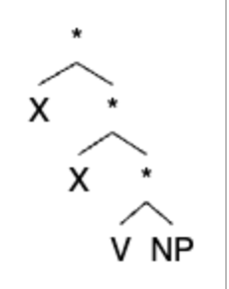
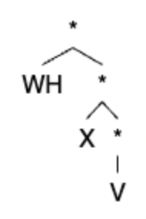
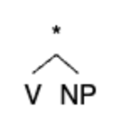
Artificially Generated Treebank
Random recursive generation of trees with the desired terminals; only retaining trees that meet licensing rules
i.e. enforcing that V terminals occur only either with a NP terminal as a right sister or c-commanded by a WH terminal
Generation of trees from a variation of the learned (has correct licensing rules) PFSTA
Max Depth | 6
Avg Depth | 2.83
Avg Depth (containing WH) | 4.34
% WH trees | 33%
% NP trees | 14%
% X only trees | 59%
Notes:
Table of tree bank stats

Slide 31
Results
Generated Treebanks
Our learner was consistently able to converge to the goal PFSTA using a generated treebank,
Successful runs typically consisted of the best likelihood from 10 random initializations, which were trained on treebanks of 100 to 200 generated trees.
Typically converged in 10 to 15 iterations of the EM algorithm.
Q: [0, 1, 2, 3, 4]
I: {1: 1.0}
Delta:
0 –^{WH}→[]: 1.0
1–*→[0,4]: 0.3069
1–*→[1,1]: 0.1693
1–*→[2,3]: 0.3968
1–^{X}→[] : 0.127
2–^{V}→[] : 1.0
3–^{NP}→[] : 1.0
4–*→[1,4]: 0.3012
4–*→[2]: 0.6988

Slide 32
Outline
“Either-Or” Dependencies & FSTAs
Expectation Maximization
Model Testing
Artificially Generated Treebank
CHILDES Treebank

Slide 33
CHILDES Treebank
CHILDES is a well-known dataset, containing parsed and annotated transcripts of conversations between children and their caregivers
Max Depth | 6
Avg Depth | 3.05
Avg Depth (containing WH) | 5.67
% WH trees | 6%
% NP trees | 33%
% X only trees | 61%
Notes:
Same for statistics

Slide 34
CHILDES Treebank Preprocessing - Algorithm
Read tree from tuple
‘Clean’ labels
WHNP → WH
Verb heads
If has an direct preceding NP sister → V
Else → X
NP
If does not have a direct following V sister → X
If has trace as direct child → trace
Else → X
Remove lexical items
Collapse unary
Star inner nodes
Check for coindexed WH and trace
Drop traces
Binarize
Notes:
Describe preprocessing algorithm

Slide 35

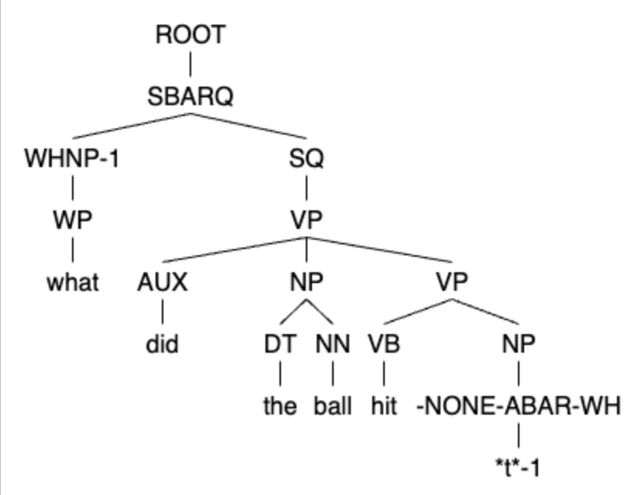
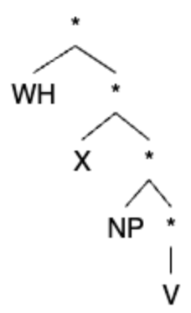
CHILDES Treebank Preprocessing
what did the ball hit t
Notes:
Describe preprocessing algorithm

Slide 36
Results
Q: [0, 1, 2, 3, 4]
I: {1: 1.0}
Delta:
0 –*→[1,1]: 0.0664
0 –*→[1,4]: 0.6064
0 –*→[2,3]: 0.0508
0 –^{WH}→[]: 0.2765
1–*→[0,1]: 0.2992
1–*→[1,1]: 0.0613
1–*→[1,4]: 0.0007
1–*→[2,3]: 0.0118
1–^{X}→[] : 0.627
2–^{V}→[] : 1.0
3–^{NP}→[] : 1.0
4–*→[1,1]: 0.2152
4–*→[1,4]: 0.1029
4–*→[2,3]: 0.2744
4–*→[2]: 0.4075
CHILDES Treebank
When our learner was given a random sample of 100 trees from the CHILDES dataset, it did not converge to the desired FSTA.
These results suggest that not enough trees in the CHILDES dataset are able to teach wh-licensing or perhaps even V-NP pairing, making it difficult for the learner to converge to the desired PFSTA.
So, let’s take a closer look at the trees resulting from our preprocessing algorithm, to check if the input treeset is reasonable…

Slide 37
CHILDES Treebank Preprocessing
Based on Pearl & Sprouse (2013), we expected approximately 15-20% of the trees in our parsed CHILDES trees to include relevant wh-dependencies. However, our criteria for a WH tree was satisfied only by about 11% of trees.
Stricter criteria for transformation from a parse to a tree containing a wh-dependency:
Contains WHNP annotation marker (rather than WHVP, for instance)
Contains trace
V & NP-trace are direct ordered sisters
Excludes ditransitive verbs with trace in direct object (in second NP)
WHNP and trace are coindexed

Slide 38
CHILDES Treebank Preprocessing
Imposing these restrictions:
Total number of trees: 46740
WHNP trees: 8790 → 18.81%
with object question: 8090 → 17.31%
with trace: 5274 →11.28%
WH trees: 2652 → 5.48%
Upon investigation, we found the majority of wh-questions ‘missed’ (the disparity in 11% and 5%) in parsing to occur for three reasons:
1) ditransitive verbs: ~500 trees
2) copular verbs (with inversion): ~1920 trees
3) verbs with object trace nested in prepositional phrases: ~60 trees

Slide 39
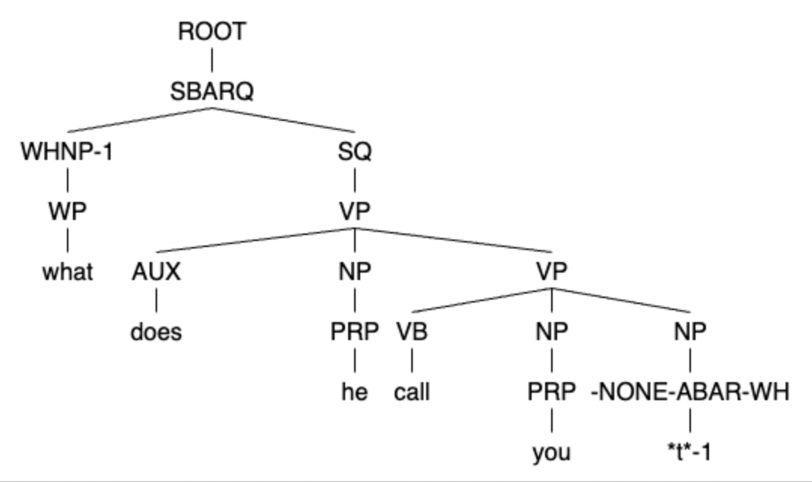
CHILDES Treebank Preprocessing - Ditransitives
Ditransitive verbs give evidence for both V-NP and WH-V constructions
In the current parsing mechanism they produce trees containing V-NP which are also necessary for our learner (and children) to learn the short distance configuration of this dependency.
ex: what does he call you t
Since instead identifying these as WH-V constructions would bar them from providing V-NP information, for the current study, we will continue to parse questions ditransitive verbs as statements.
Notes:
Switch parse and conclusion?

Slide 40
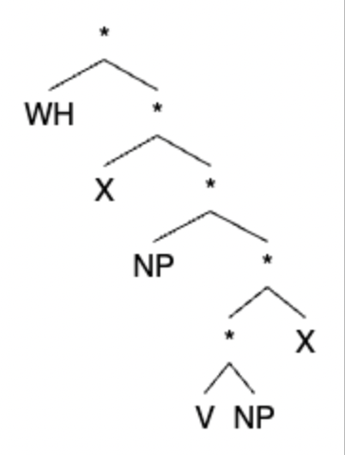
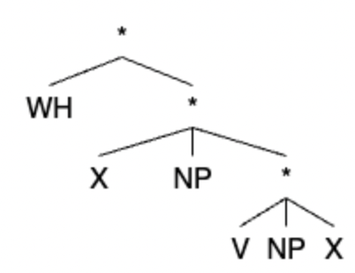
CHILDES Treebank Preprocessing - Ditransitives
what does he call you t
('ROOT', ('SBARQ', ('WHNP-1', ('WP', 'what')), ('SQ', ('VP', ('AUX', 'does'), ('NP', ('PRP', 'he')), ('VP', ('VB', 'call'), ('NP', ('PRP', 'you')), ('NP', ('-NONE-ABAR-WH', '*t*-1'))))), ('.', '?')))
X
clean labels & collapse unary
binarize
Notes:
trace is only parsed for when we are already looking at the sister of a V head, WH does not remain WH if does not have coindexed trace

Slide 41
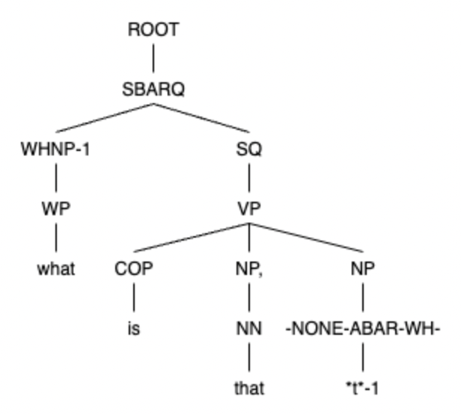
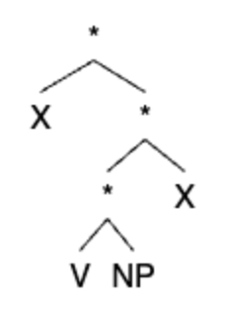
CHILDES Treebank Preprocessing - Copular Questions
Due to the inversion that occurs with question formation, the trace is clearly not the direct sister of ‘is’
But the answer to the question would become the ‘object’ of the copula.
With the current parsing, this sentence gives us a V-NP tree, but not a WH-V tree.
ex: what is that t
Despite the large number of CHILDES parses that contain such inverted questions, we did not adjust our definition of an NP-complement-selector to include these copulas as they fail the simple test of the NP-seeking head having its trace or object as a direct right sister.
Notes:
[ROOT [SBARQ [WHNP-1 [WP [what]]] [SQ [VP [COP is] [NP [NN that]] [NP [-NONE-ABAR-WH- *t*-1]]]]]]

Slide 42
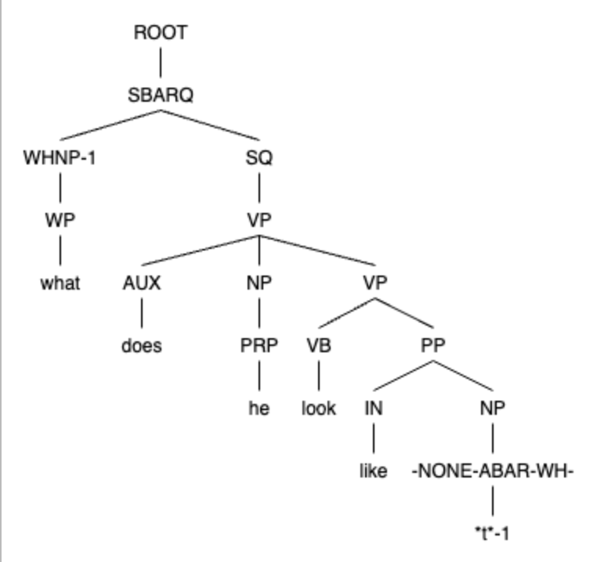
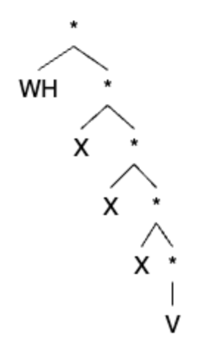
CHILDES Treebank Preprocessing - Prepositions
Allow the PP head (in ex. the node ('IN', 'like')) to become the V head and then continue parsing
Original verb is ‘ignored’ in favor of treating the trace as the complement of the preposition
ex: what does he look like t
Our learner is not concerned with identifying categories of verbs/parts of speech, these can also be serve as evidence for learning the long-distance wh-dependency. Therefore, we expand our criteria and parsing mechanism to allow preposition-trace pairs to be interpreted as gaps requiring wh-licensing.

Slide 43
CHILDES Treebank Preprocessing - Updated
To summarize these special cases:
Ditransitives
no obvious way to adjust the preprocessing
Copular questions
no obvious way to adjust the preprocessing
Prepositional phrases
Adjusted the preprocessing to allow this, but it only included 60 more trees and so didn't affect the results

Slide 44
Discussion
Why is the expectation-maximization algorithm paired with over-under values able to track long-distance licensing when trained on generated treebanks, but not when trained on CHILDES?
Hypothesis space is identically restricted in both cases, the learner's ability to converge to the desired FSTA must be due to properties of each of the treebanks.
CHILDES trees are deeper, especially on wh-questions,
Distribution of WH trees to V-NP trees to C-only trees differs
Far fewer wh-transitions in the treebanks sampled from CHILDES
Comparison suggests that additional syntactic structures (i.e. ditransitivity, subject-auxiliary inversion) may need to be in place before long-distance dependencies.
Additional assumptions would provide further information about and examples containing wh-phrase movement

